Slide 1
Internet Information Services
David Navarro Vazquez

Slide 2
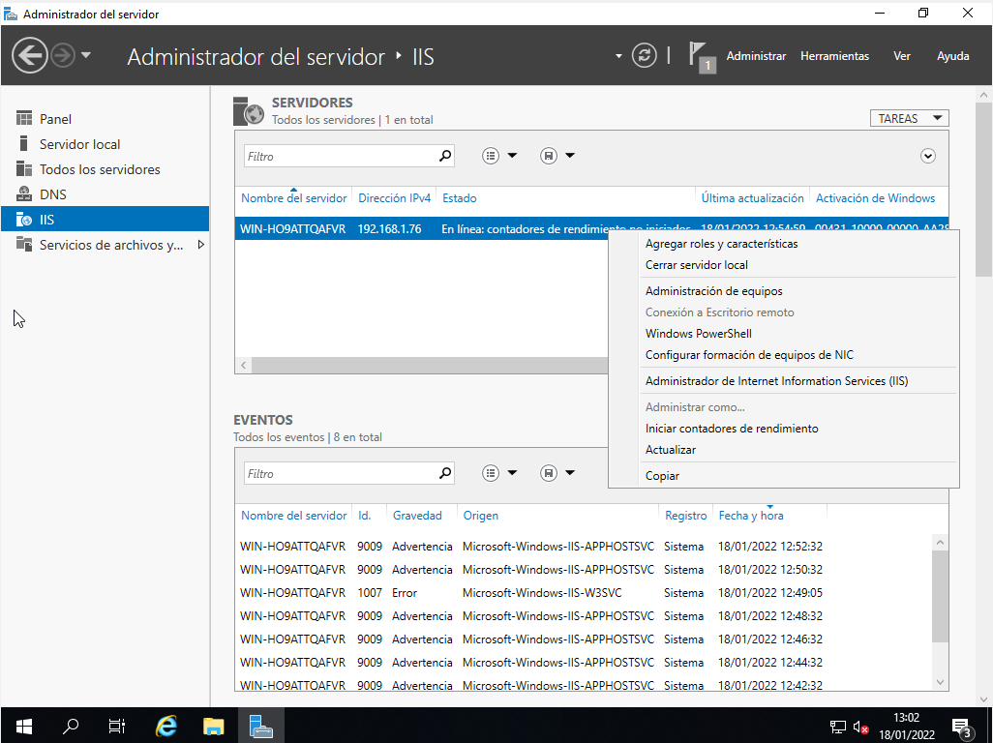
Internet Information Services

Slide 3
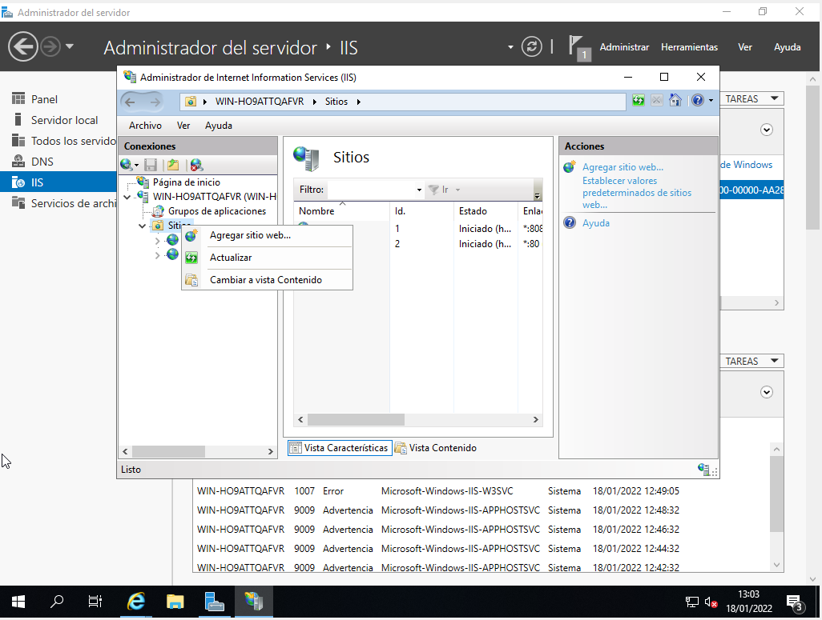
Internet Information Services

Slide 4
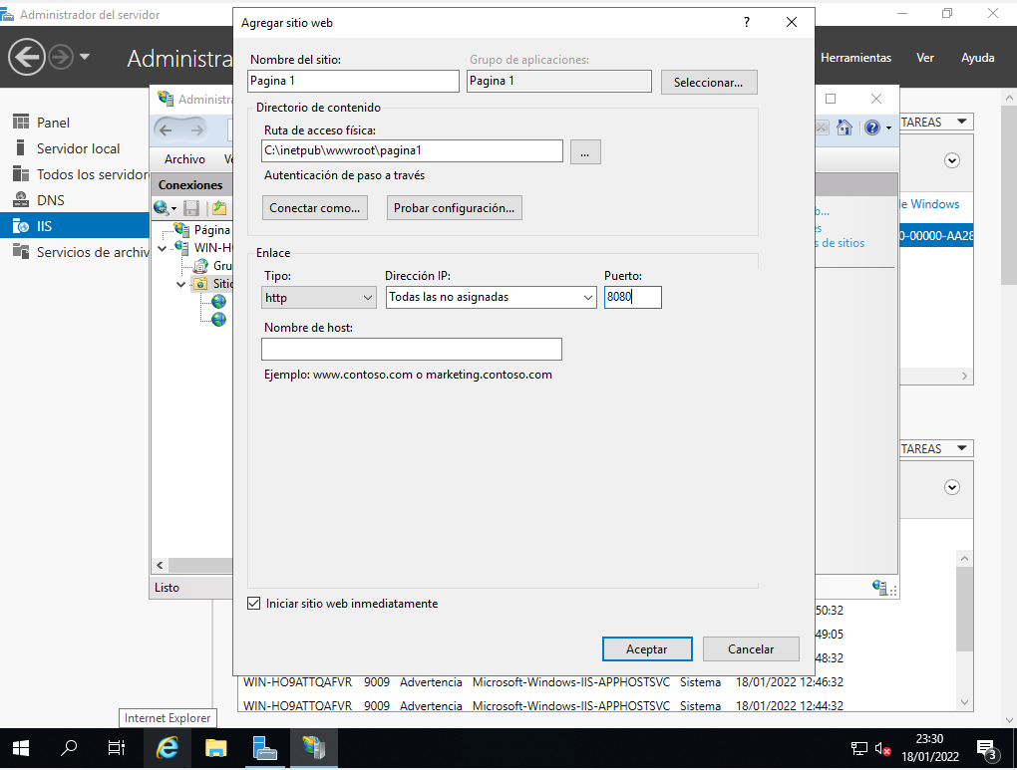
Internet Information Services

Slide 5

Internet Information Services

Slide 6
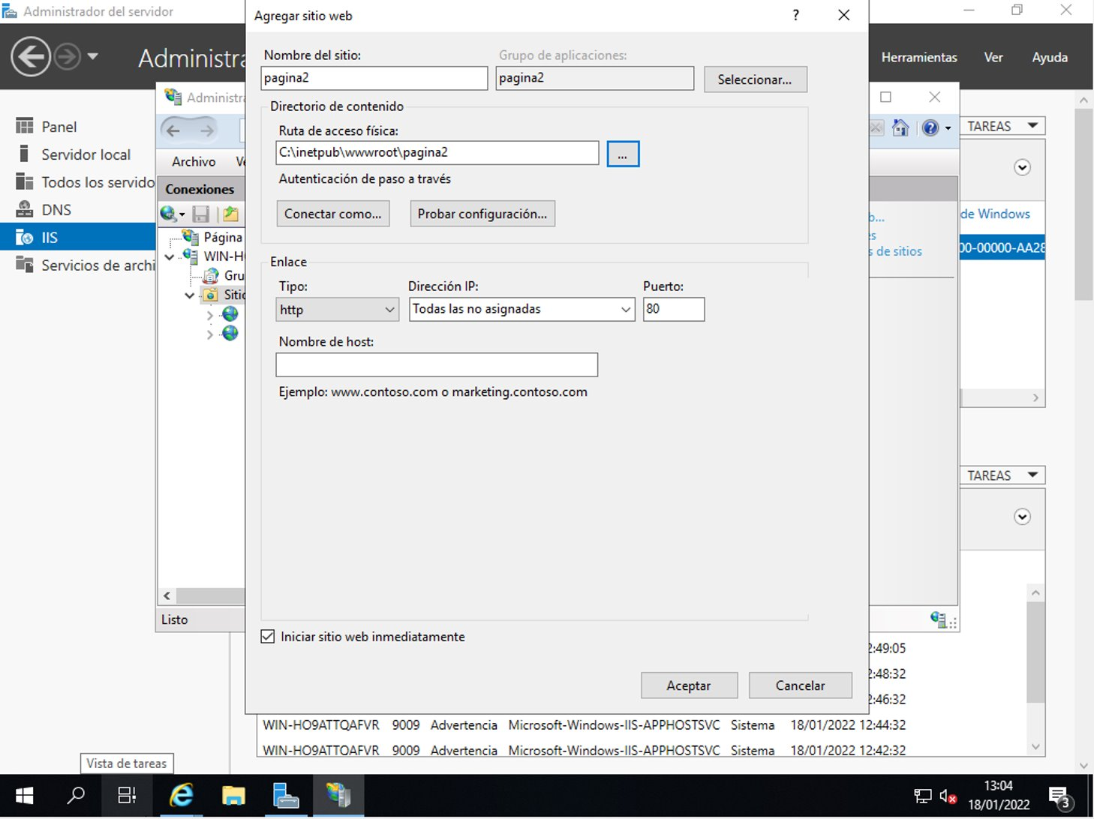
Internet Information Services

Slide 7

Internet Information Services

